Slide 2
Topics
Designing a Program
Input, Processing, and Output
Displaying Output with print Function
Comments
Variables
Reading Input from the Keyboard
Performing Calculations
String Concatenation
More About The print Function
Displaying Formatted Output
Named Constants
Introduction to Turtle Graphics

Slide 3
Designing a Program
Programs must be designed before they are written
Program development cycle:
  Design the program
  Write the code
  Correct syntax errors
  Test the program
  Correct logic errors

Slide 4
Designing a Program (cont’d.)
Design is the most important part of the program development cycle
Understand the task that the program is to perform
  Work with customer to get a sense what the program is supposed to do
  Ask questions about program details
  Create one or more software requirements

Slide 5
Designing a Program (cont’d.)
Determine the steps that must be taken to perform the task
  Break down required task into a series of steps
  Create an algorithm, listing logical steps that must be taken
Algorithm: set of well-defined logical steps that must be taken to perform a task

Slide 6
Pseudocode
Pseudocode: fake code
  Informal language that has no syntax rule
  Not meant to be compiled or executed
  Used to create model program
    No need to worry about syntax errors, can focus on program’s design
    Can be translated directly into actual code in any programming language

Slide 7
Flowcharts
Flowchart: diagram that graphically depicts the steps in a program
  Ovals are terminal symbols
  Parallelograms are input and output symbols
  Rectangles are processing symbols
  Symbols are connected by arrows that represent the flow of the program

Slide 8
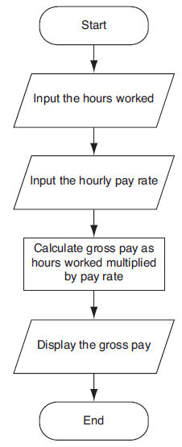

Slide 9
Input, Processing, and Output
Typically, computer performs three-step process
  Receive input
    Input: any data that the program receives while it is running
  Perform some process on the input
    Example: mathematical calculation
  Produce output

Slide 10
Displaying Output with the print Function
print function: displays output on the screen
>>> print('Hello world')
Hello world
>>>

Slide 11
Displaying Output with the print Function
Function: piece of prewritten code that performs an operation
Argument: data given to a function
  Example: data that is printed to screen
Statements in a program execute in the order that they appear
  From top to bottom

Slide 12
Program Execution Order
In a simple program, statements execute in the order they appear
  From top to bottom
print('Programming')
print('is')
print('fun!')
Program Output
Programming
is
fun!

Slide 13
Strings and String Literals
String: sequence of characters that is used as data
String literal: string that appears in actual code of a program
  Must be enclosed in single (') or double (") quote marks
  String literal can be enclosed in triple quotes (''' or """)
    Enclosed string can contain both single and double quotes and can have multiple lines

Slide 14
Comments
Comments: notes of explanation within a program
  Ignored by Python interpreter
    Intended for a person reading the program’s code
  Begin with a # character
End-line comment: appears at the end of a line of code
  Typically explains the purpose of that line

Slide 15
Variables
Variable: name that represents a value stored in the computer memory
  Used to access and manipulate data stored in memory
  A variable references the value it represents
Assignment statement: used to create a variable and make it reference data
  General format is variable = expression
    Example: age = 29
    Assignment operator: the equal sign (=)

Slide 16
Variables (cont’d.)
temperature = 75
cost = 87.99
name = 'Monty'
Assigns 75 to the temperature variable.
Assigns 87.99 to the cost variable.
Assigns the string 'Monty' to
the name variable.

Slide 17
Variables (cont’d.)
In assignment statement, variable receiving value must be on left side
A variable can be passed as an argument to a function
  Variable name should not be enclosed in quote marks
You can only use a variable if a value is assigned to it

Slide 18
Variables (cont’d.)
You can assign values to multiple variables in a single statement.
This statement makes the following assignments
  x = 0
  y = 1
  z = 2
This is known as multiple assignment
Notice the variable names on the left side of the = operator are separated by commas, and the values on the right side of the = operator are separated by commas.
x, y, z = 0, 1, 2

Slide 19
Variable Naming Rules
Rules for naming variables in Python:
  Variable name cannot be a Python key word
  Variable name cannot contain spaces
  First character must be a letter or an underscore
  After first character may use letters, digits, or underscores
  Variable names are case sensitive
Variable name should reflect its use

Slide 20
Displaying Multiple Items with the print Function
Python allows one to display multiple items with a single call to print
  Items are separated by commas when passed as arguments
  Arguments displayed in the order they are passed to the function
  Items are automatically separated by a space when displayed on screen

Slide 21
Variable Reassignment
Variables can reference different values while program is running
Garbage collection: removal of values that are no longer referenced by variables
  Carried out by Python interpreter
A variable can refer to item of any type
  Variable that has been assigned to one type can be reassigned to another type

Slide 22
Numeric Data Types, Literals, and the str Data Type
Data types: categorize value in memory
  e.g., int for integer, float for real number, str used for storing strings in memory
Numeric literal: number written in a program
  No decimal point considered int, otherwise, considered float
Some operations behave differently depending on data type

Slide 23
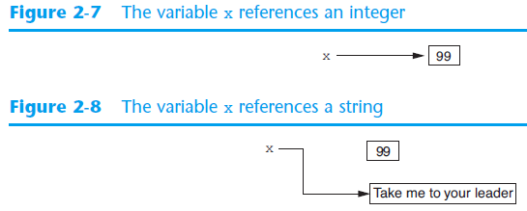
Reassigning a Variable to a Different Type
A variable in Python can refer to items of any type

Slide 24
Reading Input from the Keyboard
Most programs need to read input from the user
Built-in input function displays a prompt and reads input from keyboard
  Returns the data as a string
  Format: variable = input(prompt)
    prompt is typically a string instructing user to enter a value
  Does not automatically display a space after the prompt

Slide 25
Reading Input from the Keyboard
Example:
This statement does the following:
  Displays the string 'What is your name? '
  Reads input, as a string, from the keyboard
  Assigns the string that was read from the keyboard to the name variable
name = input('What is your name? ')

Slide 26
Reading Numbers with the input Function
input function always returns a string
Built-in functions convert between data types
  int(item) converts item to an int
  float(item) converts item to a float
  Nested function call: general format: function1(function2(argument))
    value returned by function2 is passed to function1
  Type conversion only works if item is valid numeric value, otherwise, causes an error

Slide 27
Reading Numbers with the input Function
Example:
This statement does the following:
  Displays the string 'Enter a number: '
  Reads input, as a string, from the keyboard
  Converts the input to an int
  Assigns the resulting int to the number variable
number = int(input('Enter a number: '))

Slide 28
Reading Numbers with the input Function
Example:
This statement does the following:
  Displays the string 'Enter your score: '
  Reads input, as a string, from the keyboard
  Converts the input to a float
  Assigns the resulting float to the score variable
score = float(input('Enter your score: '))

Slide 29
Performing Calculations
Math expression: performs calculation and gives a value
  Math operator: tool for performing calculation
  Operands: values surrounding operator
    Variables can be used as operands
  Resulting value typically assigned to variable
Two types of division:
  / operator performs floating point division
  // operator performs integer division
    Positive results truncated, negative rounded away from zero

Slide 30
Performing Calculations
Operators
Symbol | Operation | Description
+ | Addition | Adds two numbers
− | Subtraction | Subtracts one number from another
* | Multiplication | Multiplies one number by another
/ | Division | Divides one number by another and gives the result as a floating-point number
// | Integer Division | Divides one number by another and gives the result as a whole number
% | Remainder | Divides one number by another and gives the remainder
** | Exponent | Raises a number to a power

Slide 31
Performing Calculations
Two types of division: floating-point and integer
  The / operator performs floating point division
    Gives the result as a floating-point number
  The // operator performs integer division
    Gives the result as an integer
    Positive results are truncated
    Negative results are rounded away from zero

Slide 32
Operator Precedence and Grouping with Parentheses
Python operator precedence:
  Operations enclosed in parentheses
    Forces operations to be performed before others
  Exponentiation (**)
  Multiplication (*), division (/ and //), and remainder (%)
  Addition (+) and subtraction (-)
Higher precedence performed first
  Same precedence operators execute from left to right

Slide 33
The Exponent Operator and the Remainder Operator
Exponent operator (**): Raises a number to a power
  x ** y = x^{y}
Remainder operator (%): Performs division and returns the remainder
  a.k.a. modulus operator
  e.g., 4%2=0, 5%2=1
  Typically used to convert times and distances, and to detect odd or even numbers

Slide 34
Converting Math Formulas to Programming Statements
Operator required for any mathematical operation
When converting mathematical expression to programming statement:
  May need to add multiplication operators
  May need to insert parentheses

Slide 35
Mixed-Type Expressions and Data Type Conversion
Data type resulting from math operation depends on data types of operands
  Two int values: result is an int
  Two float values: result is a float
  int and float: int temporarily converted to float, result of the operation is a float
    Mixed-type expression
  Type conversion of float to int causes truncation of fractional part

Slide 36
Breaking Long Statements into Multiple Lines
Long statements cannot be viewed on screen without scrolling and cannot be printed without cutting off
Multiline continuation character (\): Allows to break a statement into multiple lines
    result = var1 * 2 + var2 * 3 + \
    var3 * 4 + var4 * 5

Slide 37
Breaking Long Statements into Multiple Lines
Any part of a statement that is enclosed in parentheses can be broken without the line continuation character.
    print("Monday's sales are", monday,
    "and Tuesday's sales are", tuesday,
    "and Wednesday's sales are", Wednesday)
    total = (value1 + value2 +
    value3 + value4 +
    value5 + value6)

Slide 38
String Concatenation
To append one string to the end of another string
Use the + operator to concatenate strings
>>> message = 'Hello ' + 'world'
>>> print(message)
Hello world
>>>

Slide 39
String Concatenation
You can use string concatenation to break up a long string literal
print('Enter the amount of ' +
'sales for each day and ' +
'press Enter.')
This statement will display the following:
Enter the amount of sales for each day and press Enter.

Slide 40
Implicit String Literal Concatenation
Two or more string literals written adjacent to each other are implicitly concatenated into a single string
>>> my_str = 'one' 'two' 'three'
>>> print(my_str)
onetwothree

Slide 41
Implicit String Literal Concatenation
print('Enter the amount of '
'sales for each day and '
'press Enter.')
This statement will display the following:
Enter the amount of sales for each day and press Enter.

Slide 42
More About The print Function
print function displays line of output
  Newline character at end of printed data
  Special argument end='delimiter' causes print to place delimiter at end of data instead of newline character
print function uses space as item separator
  Special argument sep='delimiter' causes print to use delimiter as item separator

Slide 43
More About The print Function
Special characters appearing in string literal
  Preceded by backslash (\)
    Examples: newline (\n), horizontal tab (\t)
  Treated as commands embedded in string

Slide 44
Displaying Formatted Output with F-strings
An f-string is a special type of string literal that is prefixed with the letter f
F-strings support placeholders for variables
>>> print(f'Hello world')
Hello world
>>> name = 'Johnny'
>>> print(f'Hello {name}.')
Hello Johnny.

Slide 45
Displaying Formatted Output with F-strings
Placeholders can also be expressions that are evaluated
>>> print(f'The value is {10 + 2}.')
The value is 12.
>>> val = 10
>>> print(f'The value is {val + 2}.')
The value is 12.

Slide 46
Displaying Formatted Output with F-strings
Format specifiers can be used with placeholders
.2f means:
  round the value to 2 decimal places
  display the value as a floating-point number
>> num = 123.456789
>> print(f'{num:.2f}')
123.46
>>>

Slide 47
Displaying Formatted Output with F-strings
Other examples:
>> num = 1000000.00
>> print(f'{num:,.2f}')
1,000,000.00
>>> discount = 0.5
>>> print(f'{discount:.0%}')
50%

Slide 48
Displaying Formatted Output with F-strings
Other examples:
>> num = 123456789
>> print(f'{num:,d}')
123,456,789
>>> num = 12345.6789
>>> print(f'{num:.2e}')
1.23e+04

Slide 49
Displaying Formatted Output with F-strings
Specifying a minimum field width:
>>> num = 12345.6789
>>> print(f'The number is {num:12,.2f}')
The number is 12,345.68
Field width = 12
The number is 12,345.68
Field width = 12

Slide 50
Displaying Formatted Output with F-strings
Aligning values within a field
  Use < for left alignment
  Use > for right alignment
  Use ^ for center alignment
Examples:
  print(f'{num:<20.2f}')
  print(f'{num:>20.2f}')
  print(f'{num:^20.2f}')

Slide 51
Displaying Formatted Output with F-strings
The order of designators in a format specifier
  When using multiple designators in a format specifier, write them in this order:
Example:
  print(f'{number:^10,.2f}')
[alignment][width][,][.precision][type]

Slide 52
Magic Numbers
A magic number is an unexplained numeric value that appears in a program’s code. Example:
amount = balance * 0.069
What is the value 0.069? An interest rate? A fee percentage? Only the person who wrote the code knows for sure.

Slide 53
The Problem with Magic Numbers
It can be difficult to determine the purpose of the number.
If the magic number is used in multiple places in the program, it can take a lot of effort to change the number in each location, should the need arise.
You take the risk of making a mistake each time you type the magic number in the program’s code.
  For example, suppose you intend to type 0.069, but you accidentally type .0069. This mistake will cause mathematical errors that can be difficult to find.

Slide 54
Named Constants
You should use named constants instead of magic numbers.
A named constant is a name that represents a value that does not change during the program's execution.
Example:
INTEREST_RATE = 0.069
This creates a named constant named INTEREST_RATE, assigned the value 0.069. It can be used instead of the magic number:
amount = balance * INTEREST_RATE

Slide 55
Advantages of Using Named Constants
Named constants make code self-explanatory (self-documenting)
Named constants make code easier to maintain (change the value assigned to the constant, and the new value takes effect everywhere the constant is used)
Named constants help prevent typographical errors that are common when using magic numbers

Slide 56
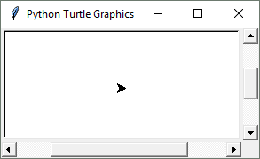
Introduction to Turtle Graphics
Python's turtle graphics system displays a small cursor known as a turtle.
You can use Python statements to move the turtle around the screen, drawing lines and shapes.

Slide 57
Introduction to Turtle Graphics
To use the turtle graphics system, you must import the turtle module with this statement:
import turtle
This loads the turtle module into memory

Slide 58
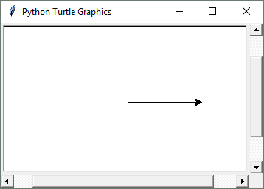
Moving the Turtle Forward
Use the turtle.forward(n) statement to move the turtle forward n pixels.
>>> import turtle
>>> turtle.forward(100)
>>>

Slide 59
Turning the Turtle
The turtle's initial heading is 0 degrees (east)
Use the turtle.right(angle) statement to turn the turtle right by angle degrees.
Use the turtle.left(angle) statement to turn the turtle left by angle degrees.

Slide 60
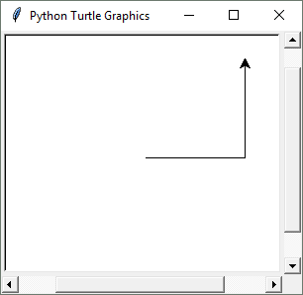
Turning the Turtle
>>> import turtle
>>> turtle.forward(100)
>>> turtle.left(90)
>>> turtle.forward(100)
>>>

Slide 61
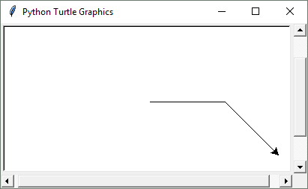
Turning the Turtle
>>> import turtle
>>> turtle.forward(100)
>>> turtle.right(45)
>>> turtle.forward(100)
>>>

Slide 62
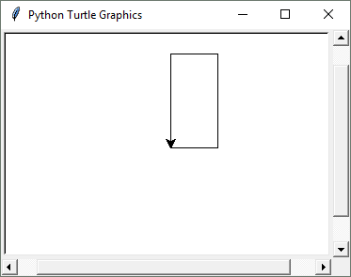
Setting the Turtle's Heading
Use the turtle.setheading(angle) statement to set the turtle's heading to a specific angle.
>>> import turtle
>>> turtle.forward(50)
>>> turtle.setheading(90)
>>> turtle.forward(100)
>>> turtle.setheading(180)
>>> turtle.forward(50)
>>> turtle.setheading(270)
>>> turtle.forward(100)
>>>

Slide 63
Setting the Pen Up or Down
When the turtle's pen is down, the turtle draws a line as it moves. By default, the pen is down.
When the turtle's pen is up, the turtle does not draw as it moves.
Use the turtle.penup() statement to raise the pen.
Use the turtle.pendown() statement to lower the pen.

Slide 64
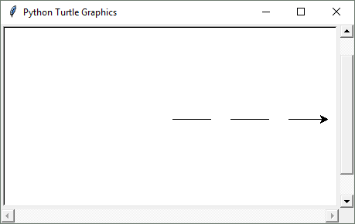
Setting the Pen Up or Down
>>> import turtle
>>> turtle.forward(50)
>>> turtle.penup()
>>> turtle.forward(25)
>>> turtle.pendown()
>>> turtle.forward(50)
>>> turtle.penup()
>>> turtle.forward(25)
>>> turtle.pendown()
>>> turtle.forward(50)
>>>

Slide 65
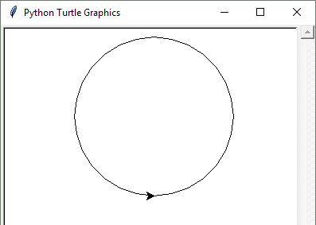
Drawing Circles
Use the turtle.circle(radius) statement to draw a circle with a specified radius.
>>> import turtle
>>> turtle.circle(100)
>>>

Slide 66
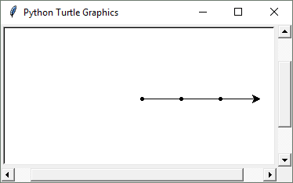
Drawing Dots
Use the turtle.dot() statement to draw a simple dot at the turtle's current location.
>>> import turtle
>>> turtle.dot()
>>> turtle.forward(50)
>>> turtle.dot()
>>> turtle.forward(50)
>>> turtle.dot()
>>> turtle.forward(50)
>>>

Slide 67
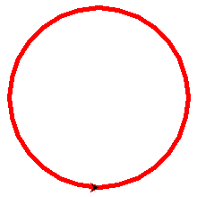
Changing the Pen Size and Drawing Color
Use the turtle.pensize(width) statement to change the width of the turtle's pen, in pixels.
Use the turtle.pencolor(color) statement to change the turtle's drawing color.
  See Appendix D in your textbook for a complete list of colors.
>>> import turtle
>>> turtle.pensize(5)
>>> turtle.pencolor('red')
>>> turtle.circle(100)
>>>

Slide 68
Working with the Turtle's Window
Use the turtle.bgcolor(color) statement to set the window's background color.
  See Appendix D in your textbook for a complete list of colors.
Use the turtle.setup(width, height) statement to set the size of the turtle's window, in pixels.
  The width and height arguments are the width and height, in pixels.
  For example, the following interactive session creates a graphics window that is 640 pixels wide and 480 pixels high:
>>> import turtle
>>> turtle.setup(640, 480)
>>>

Slide 69
Resetting the Turtle's Window
The turtle.reset() statement:
  Erases all drawings that currently appear in the graphics window.
  Resets the drawing color to black.
  Resets the turtle to its original position in the center of the screen.
  Does not reset the graphics window’s background color.
The turtle.clear() statement:
  Erases all drawings that currently appear in the graphics window.
  Does not change the turtle's position.
  Does not change the drawing color.
  Does not change the graphics window’s background color.
The turtle.clearscreen() statement:
  Erases all drawings that currently appear in the graphics window.
  Resets the drawing color to black.
  Resets the turtle to its original position in the center of the screen.
  Resets the graphics window’s background color to white.

Slide 70
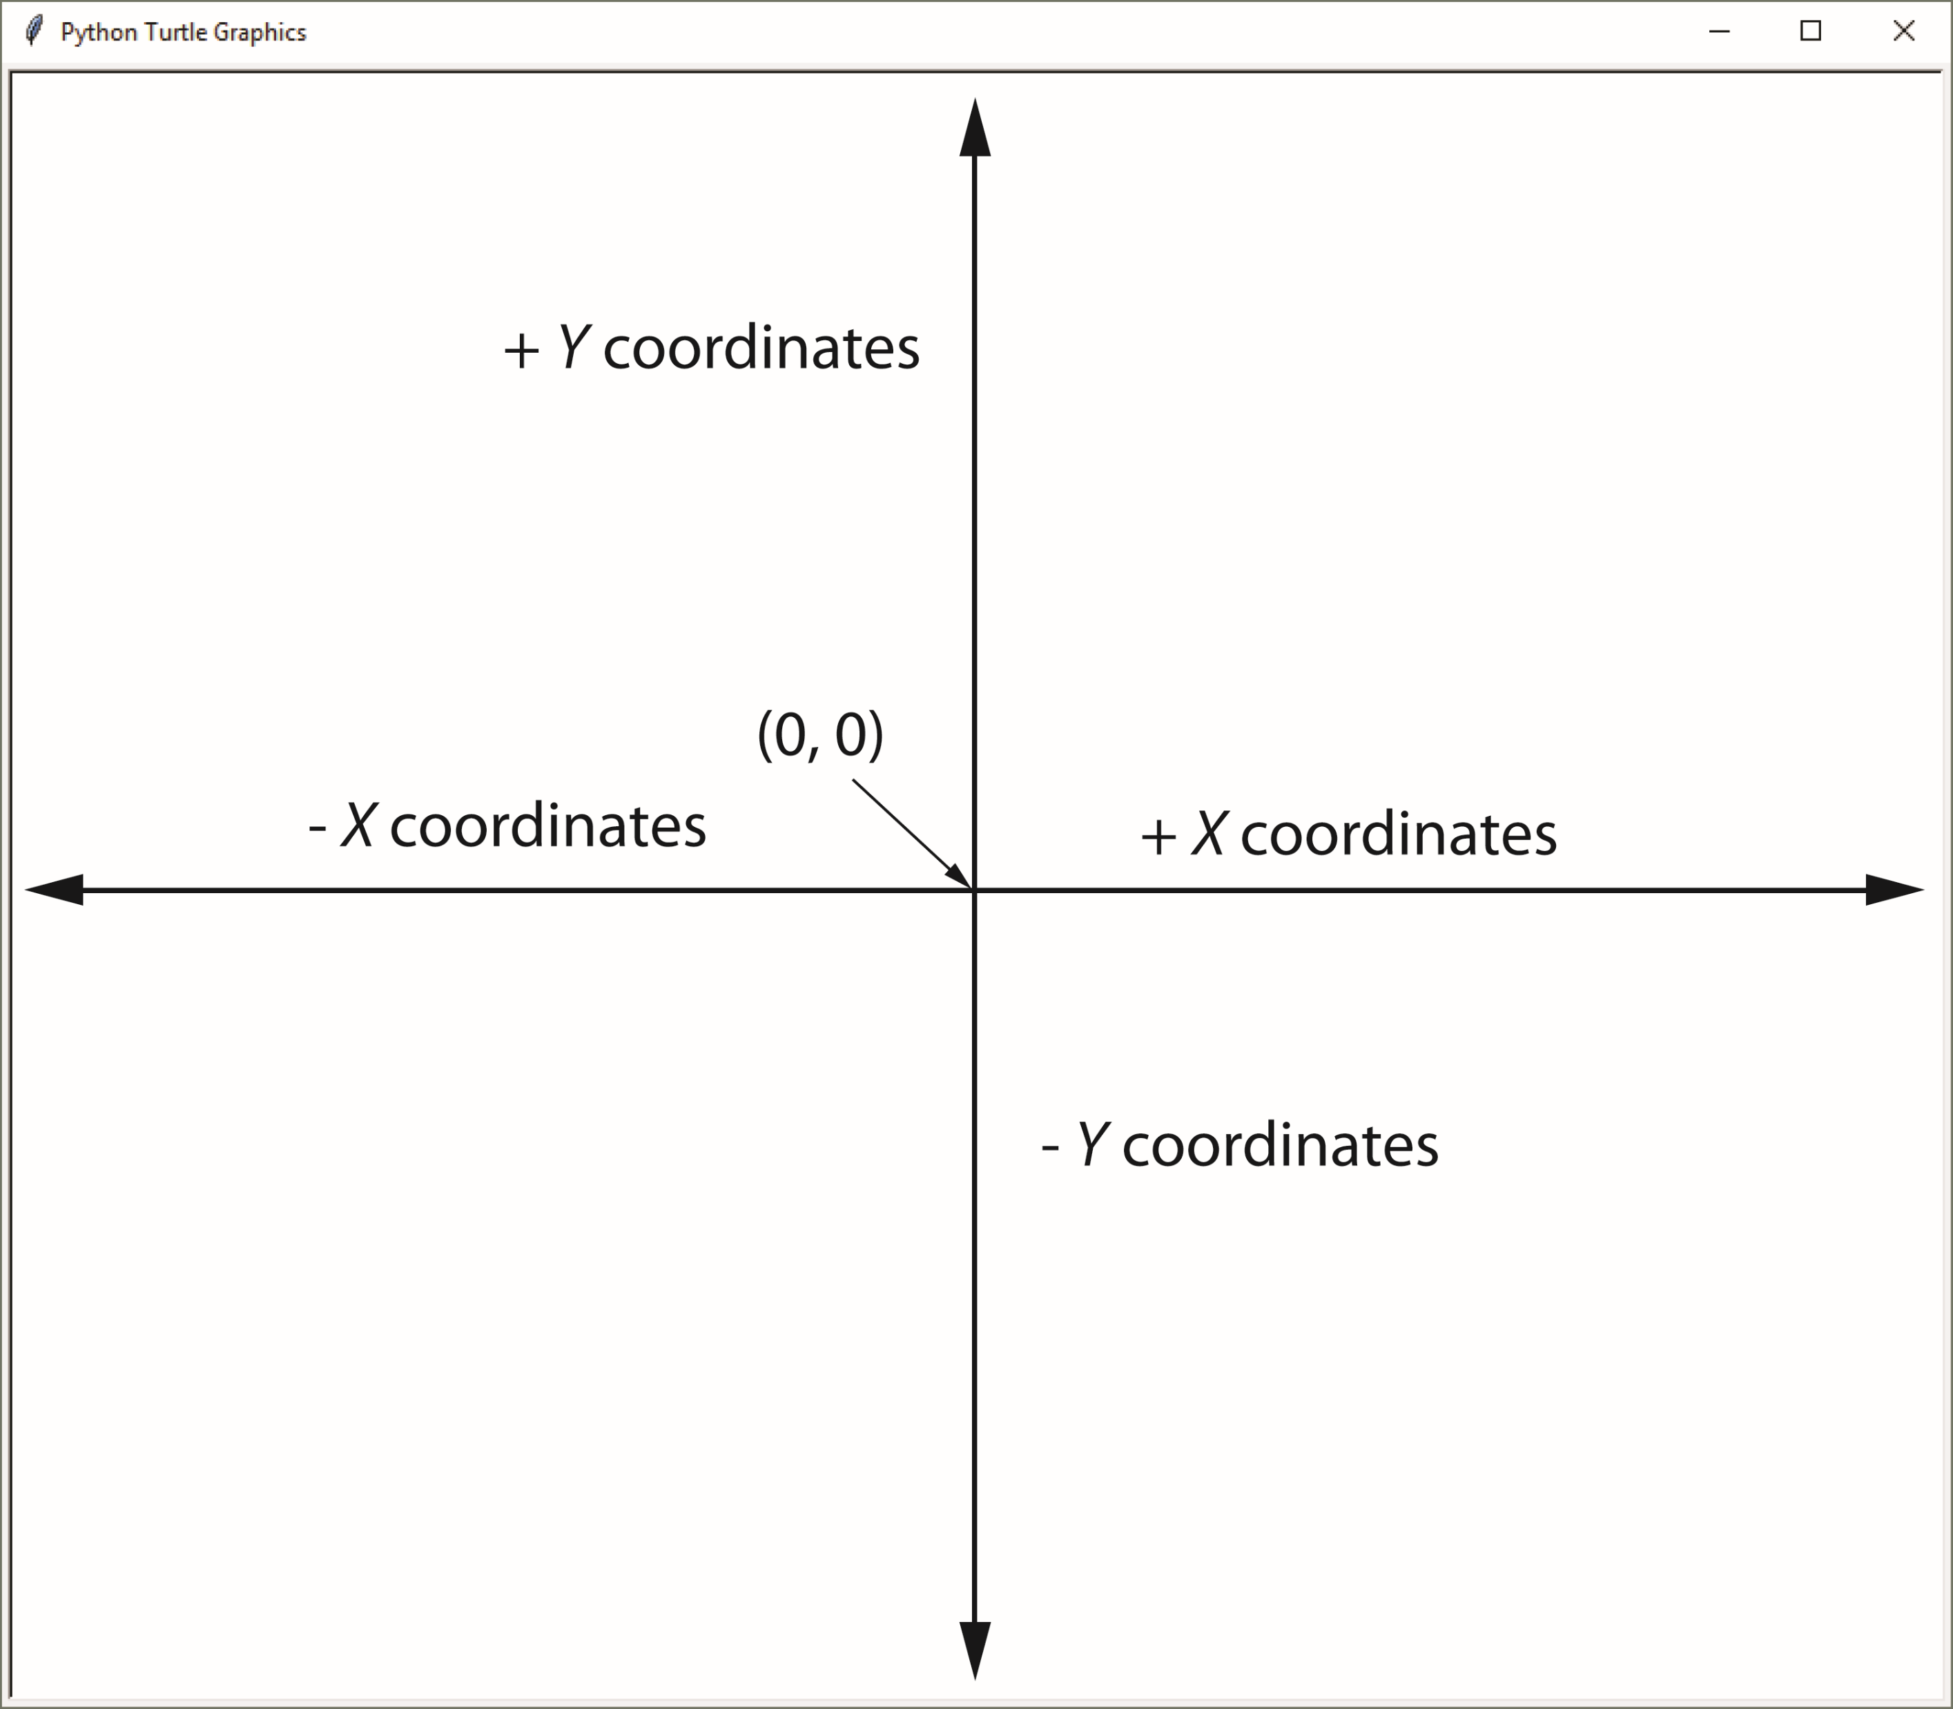
Working with Coordinates
The turtle uses Cartesian Coordinates

Slide 71
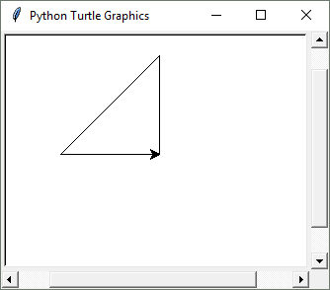
Moving the Turtle to a Specific Location
Use the turtle.goto(x, y) statement to move the turtle to a specific location.
>>> import turtle
>>> turtle.goto(0, 100)
>>> turtle.goto(−100, 0)
>>> turtle.goto(0, 0)
>>>
The turtle.pos() statement displays the turtle's current X,Y coordinates.
The turtle.xcor() statement displays the turtle's current X coordinate and the turtle.ycor() statement displays the turtle's current Y coordinate.

Slide 72
Animation Speed
Use the turtle.speed(speed) command to change the speed at which the turtle moves.
  The speed argument is a number in the range of 0 through 10.
  If you specify 0, then the turtle will make all of its moves instantly (animation is disabled).

Slide 73
Hiding and Displaying the Turtle
Use the turtle.hideturtle() command to hide the turtle.
  This command does not change the way graphics are drawn, it simply hides the turtle icon.
Use the turtle.showturtle() command to display the turtle.

Slide 74
Displaying Text
Use the turtle.write(text) statement to display text in the turtle's graphics window.
  The text argument is a string that you want to display.
  The lower-left corner of the first character will be positioned at the turtle’s X and Y coordinates.

Slide 75
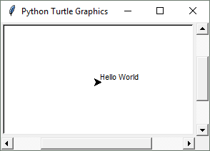
Displaying Text
>>> import turtle
>>> turtle.write('Hello World')
>>>

Slide 76
Filling Shapes
To fill a shape with a color:
  Use the turtle.begin_fill() command before drawing the shape
  Then use the turtle.end_fill() command after the shape is drawn.
  When the turtle.end_fill() command executes, the shape will be filled with the current fill color

Slide 77
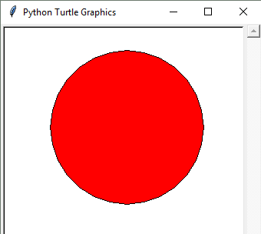
Filling Shapes
>>> import turtle
>>> turtle.hideturtle()
>>> turtle.fillcolor('red')
>>> turtle.begin_fill()
>>> turtle.circle(100)
>>> turtle.end_fill()
>>>

Slide 78
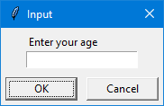
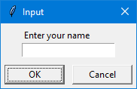
Getting Input With a Dialog Box
>>> import turtle
>>> age = turtle.numinput('Input', 'Enter your age')
>>> import turtle
>>> name = turtle.textinput('Input', 'Enter your name')

Slide 79
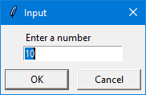
Getting Input With a Dialog Box
Specifying a default value, minimum value, and maximum value with turtle.numinput:
An error message will be displayed if the input is less than minval or greater than maxval
>>> import turtle
>>> num = turtle.numinput('Input', 'Enter a number',
default=10, minval=0, maxval=100)

Slide 80
Keeping the Graphics Window Open
When running a turtle graphics program outside IDLE, the graphics window closes immediately when the program is done.
To prevent this, add the turtle.done() statement to the very end of your turtle graphics programs.
  This will cause the graphics window to remain open, so you can see its contents after the program finishes executing.

Slide 81
Summary
This chapter covered:
  The program development cycle, tools for program design, and the design process
  Ways in which programs can receive input, particularly from the keyboard
  Ways in which programs can present and format output
  Use of comments in programs
  Uses of variables and named constants
  Tools for performing calculations in programs
  The turtle graphics system

